Slide 1

Module Code
Topic of Interest
ST1502, CA1
Infocomm Technologies
The Rise of
Data Analytics
Objectives
1
What are the most relevant “Data Analytics” skills that are highly sought after?
S/N | Student ID | Name | Dashboard
3 | p2011828 | Fleming
14 | p2030920 | Jennifer
7 | p2011972 | Reshma
2
What are the courses that working adults and students like us can attend to refine our skills?

Slide 2
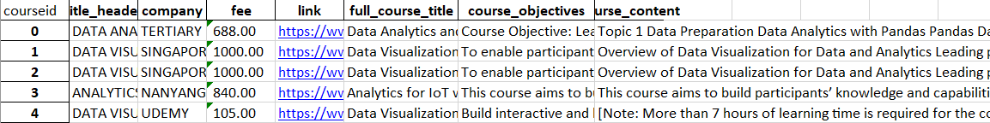
Explain the Dataset(s)
Glassdoor Job Listing
Records: 3999
Field Names: 18
Size: 0.026MB
Indeed Job Listing
https://sg.indeed.com
Records: 5047
Field Names: 13
Size: 2.46MB
SkillsFuture Courses
Skills Future
Records: 112
Field Names: 7
Size: 0.055MB

Slide 3
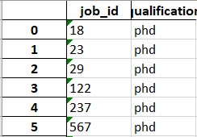
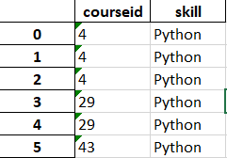
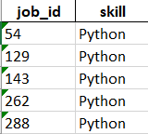
Explain the Dataset(s)
Job Qualifications
Course Skills
Records: 1096
Records: 242
Field Names: 2
Field Names: 2
Size: 0.026MB
Size: 0.010MB
Job Skills
Records: 4908
Field Names: 2
Size: 0.040MB

Slide 4
Data Wrangling
Get data
Clean data
EDA
Recommendations

Slide 5
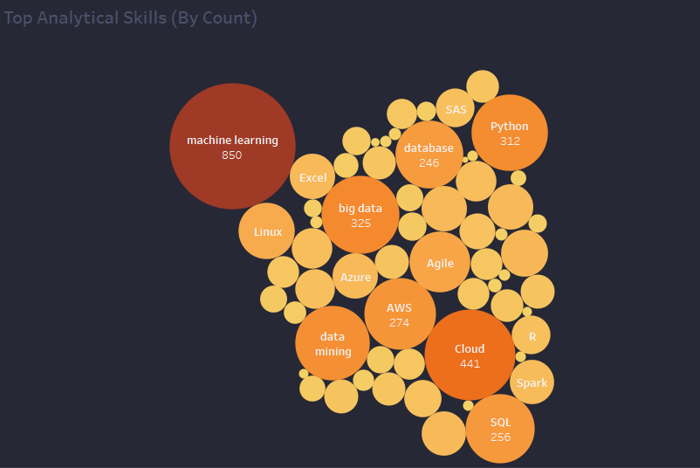
Insights
Figure 1
The most common skills that every job is looking for is Machine Learning
Machine Learning, Cloud and Big Data are some of the top few transferable skills (Commonly sought after across data-related jobs)
Figure 1

Slide 6
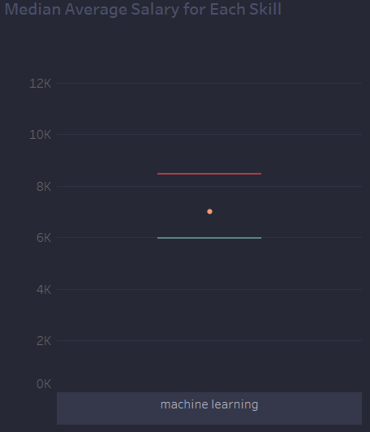
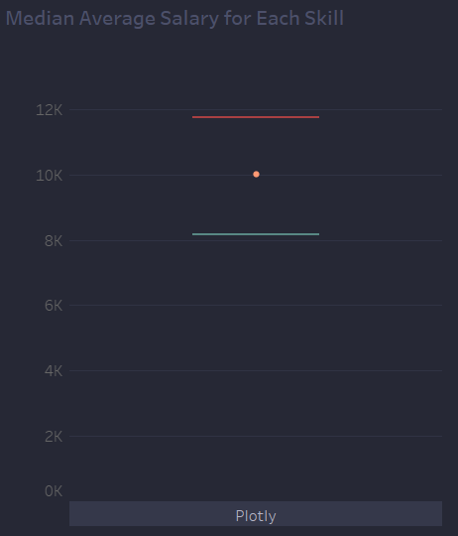
Insights
Figure 2
Common skills may not give the highest salary(e.g. Machine Learning is the most common skill, but Plotly provides a higher median salary)
Figure 2

Slide 7
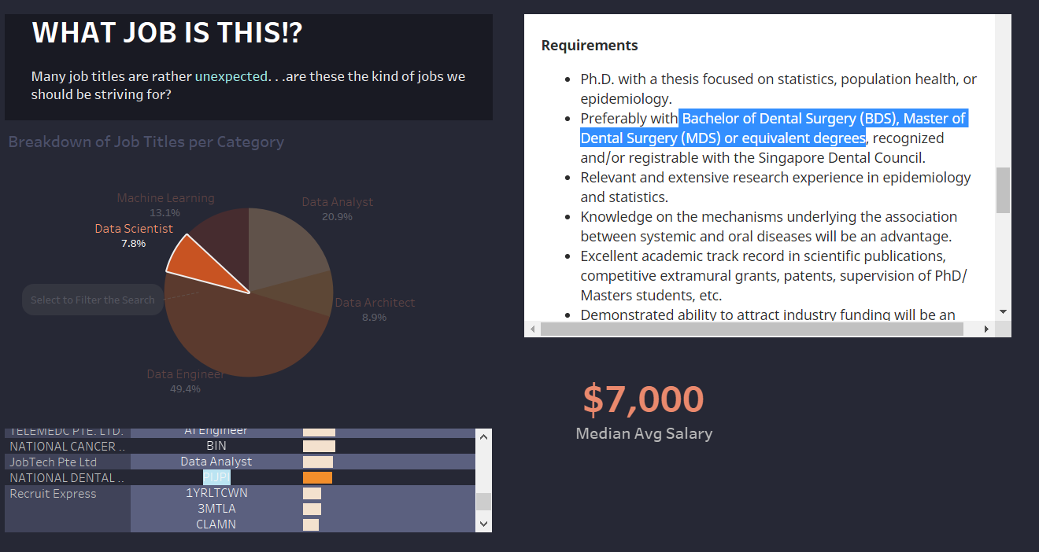
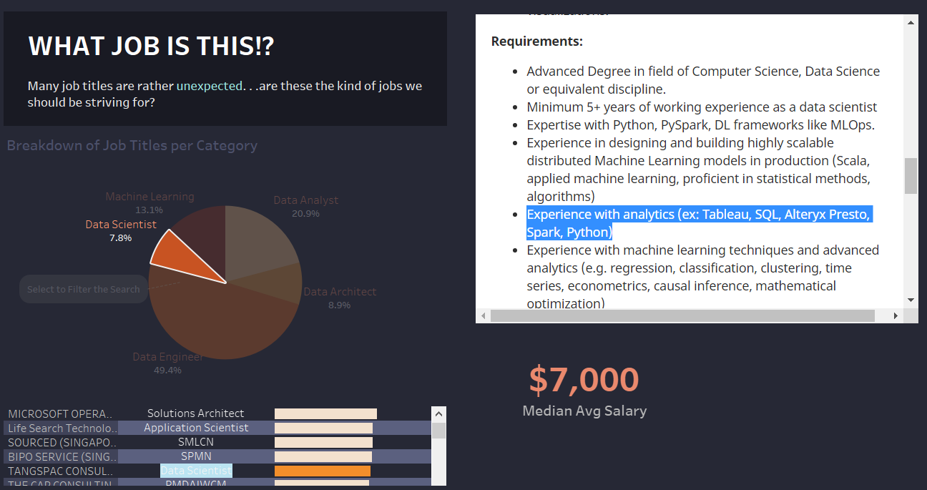
Insights
Figure 3
Some data related jobs require other scopes of education(e.g. science field)
Figure 3
Figure 4
Some jobs under specific job titles may require skills from other job titles (e.g. data scientist requiring analytical skills)
Figure 4

Slide 8
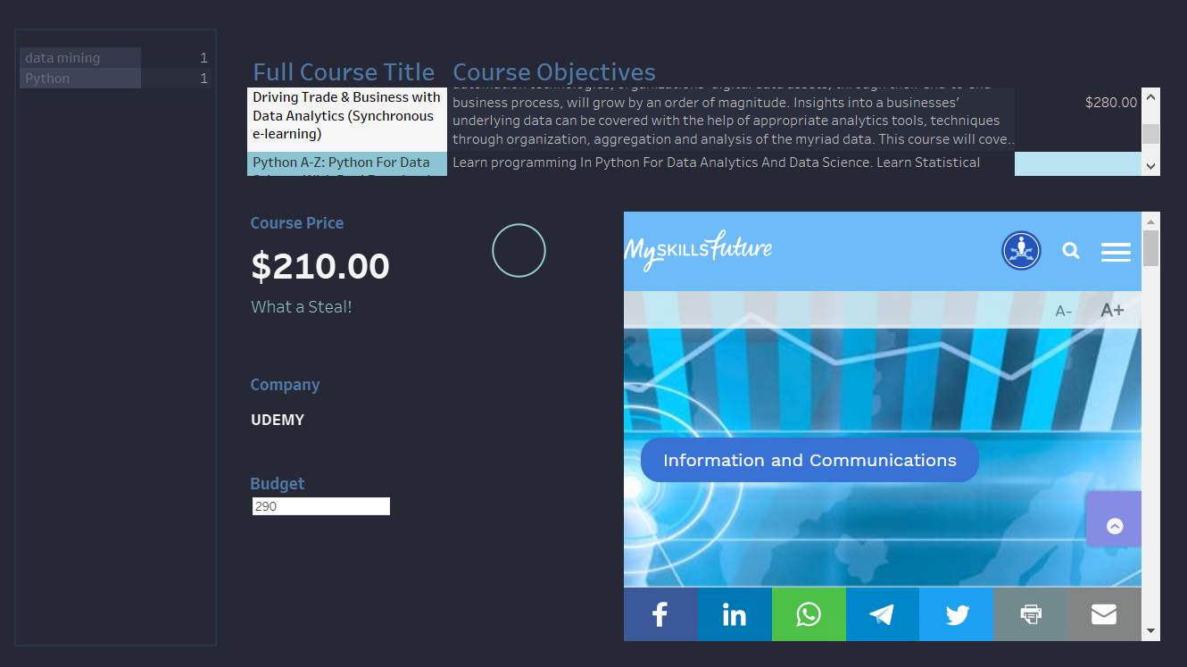
Insights
Figure 5
Prices can vary a lot between courses and companies despite the same skills being taught
Figure 5

Slide 9
Summary of Key Insights
1
Overall, Python, Excel, and Machine Learning are the top three languages and skills most wanted in job industries.
2
However, if you’re looking for a good salary in an established company, knowing the basic top skills might not be enough
3
The number of jobs related to Data Analytics can come from many different, diverse industries and sectors.

Slide 10
Recommendations
1
Demonstrate you can skillfully do data analysis and become proficient in Machine Learning.
2
Master a or many deep learning frameworks. Being proficient with a deep learning framework is crucial to being proficient with machine learning.
3
Between Python and R, choose Python. However if you have already mastered Python, consider R to become more marketable.
4
If you plan to get started on learning the most relevant skills, Udemy might be the best, as it offers a diverse range of skills at a cheap price.

Slide 11
THANKS
Do you have any questions?

